Slide 1
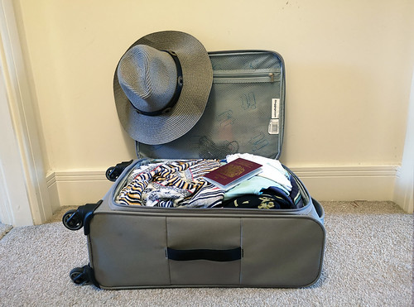

The Success of a Trip
Can be determined
By……..
Well
Packed
Bag
This Photo by Unknown Author is licensed under CC BY
Notes:
The success of a good trip can be defined by a well packed bag. We tend to put a lot of thought into the contents of our luggage based on our destination, the weather and how long we plan to stay. It’s important we pack items that are relevant to ensure that our trip will be successful.

Slide 2
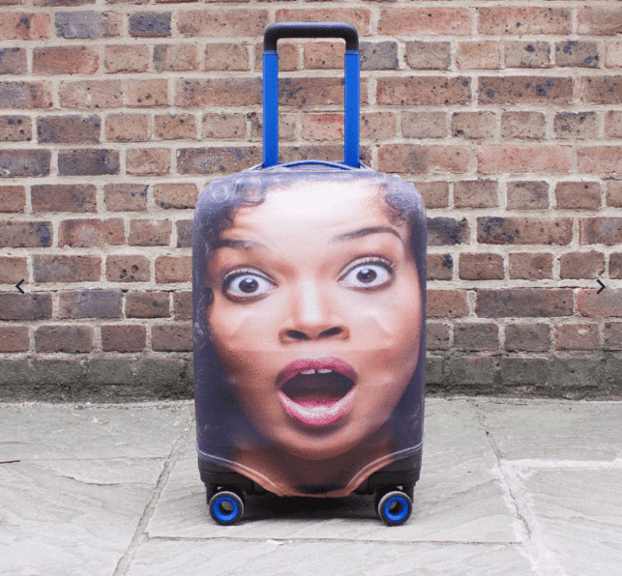
News media sources have packed our bag with fear and misinformation
This Photo by Unknown Author is licensed under CC BY-NC-ND
Notes:
The news media has put unwanted items in our luggage. Everywhere you look you can read a news story or a tweet emphasizing concern in the safety of air travel. Are they really telling us the whole story? Are we only getting what they want us to hear? Is air travel really that unsafe?

Slide 3

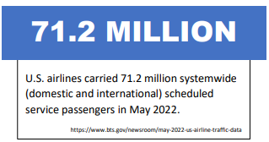
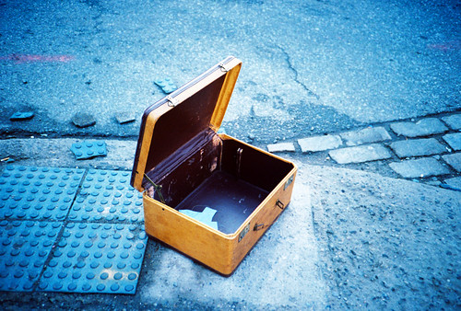
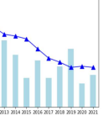
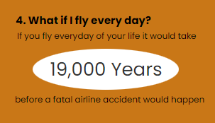
It’s Time to pack
our luggage with
Meaningful
Information…..
This Photo by Unknown Author is licensed under CC BY-NC-ND
Notes:
Its time we start packing information in our luggage that will help us to be well informed and understand what is happening with airline travel safety. We need to stop the scare tactics that keep us from visiting friends and loved ones.
Over 71 Million people used airline travel in May of 2022, one month!
Year after year we continue to see a decline in the number of accidents involving airline travel.
If I were to fly every single day of my life, it would take 19,000 years before an airline accident would happen
This kind of information is mind blowing…..

Slide 4
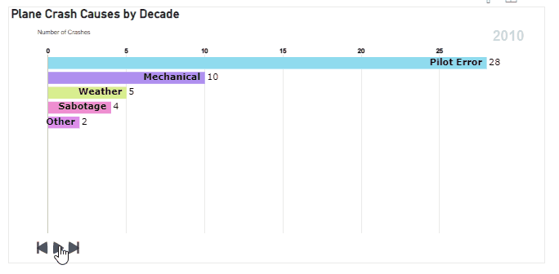
Notes:
Let’s look at Plane Crash Causes by Decade, starting in the 1950s, the largest contributor of plane crashes is pilot error, at 82. As the years progress through 1960, 1970, 1980, 1990, 2000 you will notice the measure get reduced smaller and smaller where in 2010, pilot error was at 28. For an entire decade.

Slide 5
WeFly Commitment
Safety
Big Data
Artificial Intelligence
Notes:
At WeFly we understand your concerns, and we are making every effort to address those concerns. Safety always has and always will be a top priority at WeFly. Technology and innovative training techniques help us to alleviate potential accidents before they can even occur. We have invested a large amount of time and money into big data and the proven concepts of artificial intelligence.

Slide 6
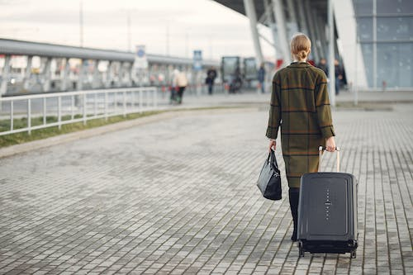
Come Fly with us…
Notes:
Time to get your bags packed and come fly with us. WeFly is committed to filling your luggage with the information you need to ensure the safest possible flight.

